Slide 1

Image Formation of Optical Coherence Tomography
Yoshiaki YASUNO
Computational Optics Group, University of Tsukuba
Disclosure
Nikon (F), Yokogawa (F), Topcon (F), Sky Technology (F), Kao (F), Sigmal LIS (F)

Slide 2
Outline
What is OCT: history and sub-types.
Basic OCT-imaging property.
How to improve imaging performance.
Extension of OCT imaging function.
Why we need to revisit OCT imaging theory?

Slide 3
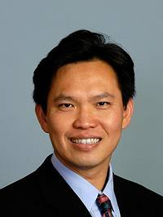
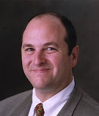
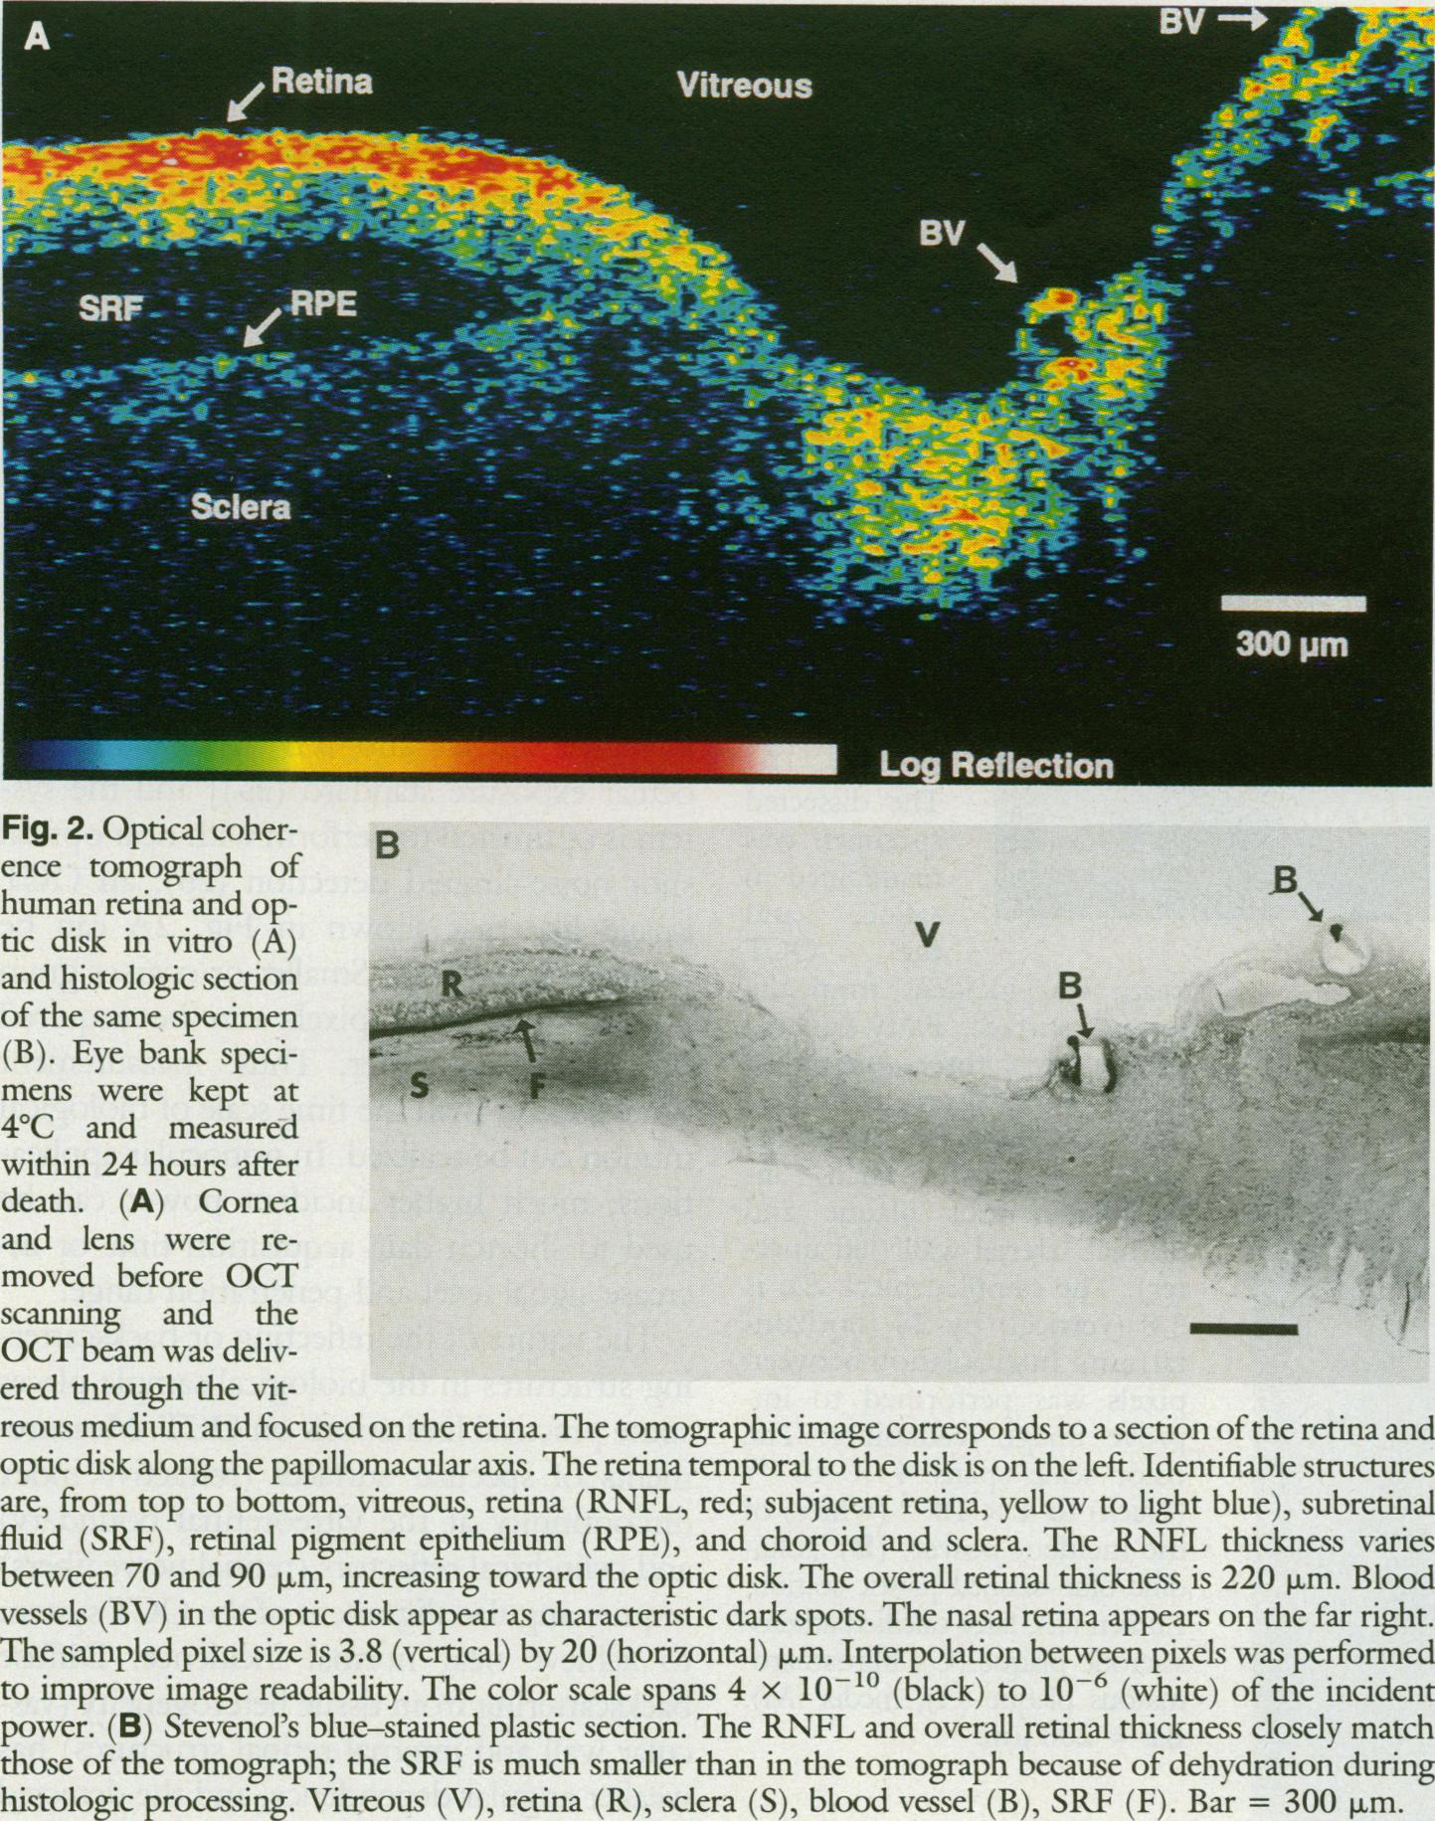
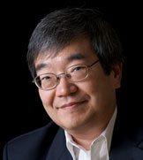
Huang, Science (1991)
Ex vivo porcine retina/optic nerve head
Huang
Schuman
D. Huang, E. Swanson, C.P. Lin, J.S. Shuman, W. G. Stinson, W. Chang, M.R. Hee, T. Flotte, K. Gregory, C.A. Puliafito, J.G. Fujimoto (Medical, Engineering, MD-PhD)
Fujimoto
Huang et al., Science 254, 1178-1181 (1991).
Notes:
http://www.octnews.org/topic/profile/david-huang/
http://www.mirm.pitt.edu/people/bios/Schuman1.asp

Slide 4
Sub-types of OCT
Optical Coherence Tomography (OCT)
Time domain OCT
Fourier domain OCT
Point detection
Line detection
2-D scan for 2-D image
1-D scan for 2-D image
long measurement time
High optical efficiency
Relatively low sensitivity
Better S/N around +20 dB
High-Speed and
3-D Tomography
Spectral domain OCT
Swept source OCT
with spectrometer
with wavelength-sweeping light source
Suitable for λ < 1 μm
Suitable for λ ≥ 1 μm

Slide 5
Basic Imaging Theory of OCT

Slide 6
Structure resolving principle
Time-delay (Time-domain OCT)
Low coherence
interferometry
Axial
Spectral interferometry (Fourier-domain OCT)
3D resolution
Point-scanning
= Reflection confocal
Lateral
Line-field imaging
Spatially incoherent
Full-field imaging
Spatially coherent

Slide 7
Structure resolving principle
Full-field imaging
Point-scanning
Line-field imaging
Incoherent
Coherent
Classic TD-OCT
FF-OCT
TD-OCT
NA
Huang, Science 254, 1178-1181 (1991).
Dubois, Appl. Opt. 41, 805- (2002).
High speed
High resolution
Classic FD-OCT
LF-SD-OCT
FF-SS-OCT
Fechting, BOE, 6, 2156- (2015).
FD-OCT
Häusler, J. Biomed. Opt. 3, 21-31 (1998).
Hillmann, Opt. Express 25, 27770- (2017).
Nakamura, Opt. Express 15, 7103- (2007).
Current standard
Standard

Slide 8
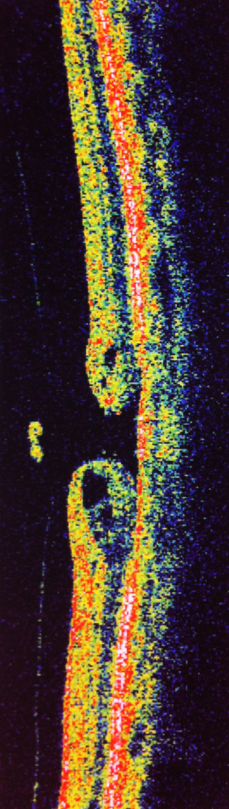
Time-domain OCT

Slide 9
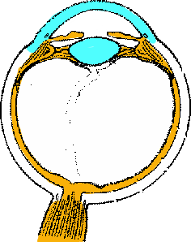
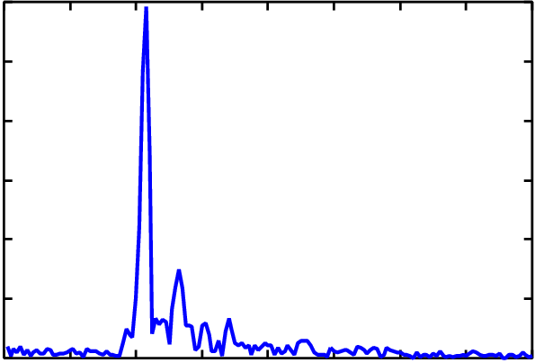
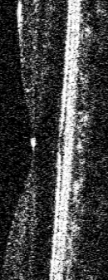
Fourier-domain (spectral-domain) OCT
Low coherence interferometer
Coupler
Broadband Source
Reference (Fixed)
B-Scan
Spectrometer
Line sensor
Signal Processing

Slide 10
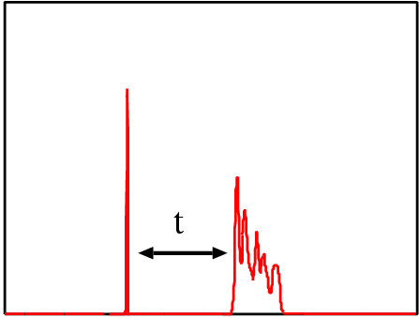
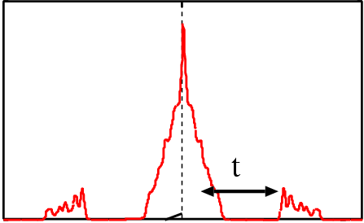
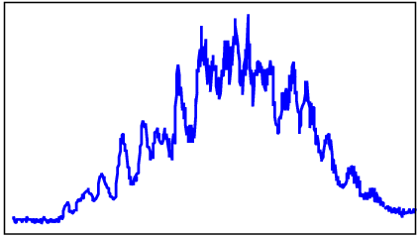
Principle of FD-OCT
Time signal
Spectrum
Reference
Intensity
Fourier Trans.
Intensity
Probe
Spectrometer
CCD
Time = depth
Wiener-Khinchine's
Loop
Auto correlation
Power spectrum
Auto correlation
Correlation
i-Fourier Trans.
Intensity
Conjugate
DSP
Correlation distance
k
Cross-correlation
＝ OCT signal

Slide 11
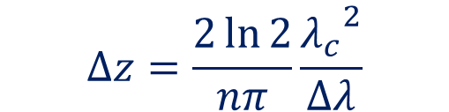
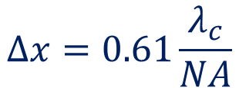
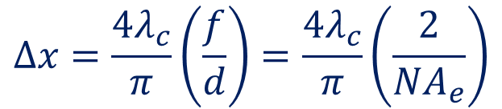
Resolutions of OCT
Axial resolution
Examples
= temporal coherence length
for λ_{c} = 840 nm, Δλ = 50 nm, n = 1.38
Δz = 4.5 μm in tissue
$$∆z=\frac{2\ln{2}}{nπ}\frac{{λ_{c}}^{2}}{Δλ}$$
for f = 30 mm, d = 2 mm, point scan
Δx = 16.0 μm in tissue
Refractive index
for NA = 0.06, flood-illumination
Δx = 8.54 μm
Lateral resolution
Scanning
Focal length
Open Issues
$$∆x=\frac{4λ_{c}}{π}\left(\frac{f}{d}\right)=\frac{{4λ}_{c}}{π}\left(\frac{2}{{NA}_{e}}\right)$$
x-z separability assumption
Beam width
Speckle-limit of practical resolution
Flood-illumination (spatially incoherent)
Limited depth-of-focus
$$∆x=0.61\frac{λ_{c}}{NA}$$

Slide 12
Axial-Lateral interaction
NA = 0.5
For high NA, the PSF skews in axial (z) - lateral (r) space!
Villiger, JOSA A 27, 2216- (2010).
Axial and lateral PSFs are not separable for high NA!

Slide 13
Speckle in OCT
Coherent imaging
Inevitable speckle
Incoherent FF-OCT
Speckle size = resolution
→ limited structural visibility
No speckle
E.g., Schumitt, J. Biomed. Opt. 4, 95- (1995).
E.g., Latrive, BOE 2, 2897- (2011)
Speckle reduction
Exploiting speckle
Elastography
OCT angiography
Practical resolution cannot be described
by standard theory!
Averaging
Sophisticated statistical image processing
Spaide, Am. J. Ophthalmol 146, 496- (2008).
For example, Ralston et al.
DOI: 10.1007/978-3-319- 06419-2_14 (2015).
Z. Jian, Opt. Lett. 34, 1516- (2009).
Li, Opt. Lett. 44, 787- (2019).
Mariampillai, Opt. Lett. 33, 1530- (2008).

Slide 14
High-Resolution Imaging

Slide 15
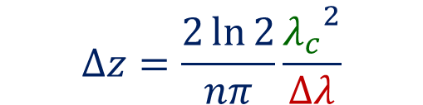
Ultra-high-resolution OCT
$$∆z=\frac{2\ln{2}}{nπ}\frac{{λ_{c}}^{2}}{Δλ}$$
Broad band light source
Visible Light OCT
Δz ~ 1 μm in tissue KLM Ti:Sa laser, TD-OCT 350-nm width @ 800 nm
Northwestern Univ. Δz ~ 0.97 μm in air Super continuum, SD-OCT 506 - 621 nm
Δz ~ 2.1 μm Ti:Sa laser, SD-OCT 144-nm width @ 800 nm
In vivo human
S. Chen, BOE 8, 1416- (2017).
In vivo human
UC Davis
SP. Chon, BOE 8, 323- (2017).
Δz < 2 μm in air Super continuum, SD-OCT 100-nm width @ 575 nm
Drexler Opt. Lett.
24, 1221- (1999).
Wojtkoski, Opt. Express 12, 2404- (2004).
Notes:
SuperK EXTREME EXW-6, NKT Photonics

Slide 16
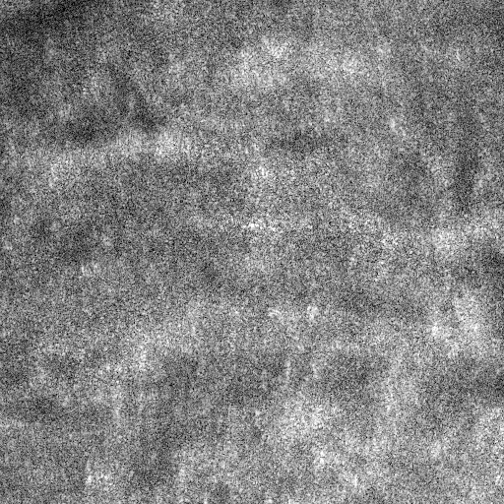
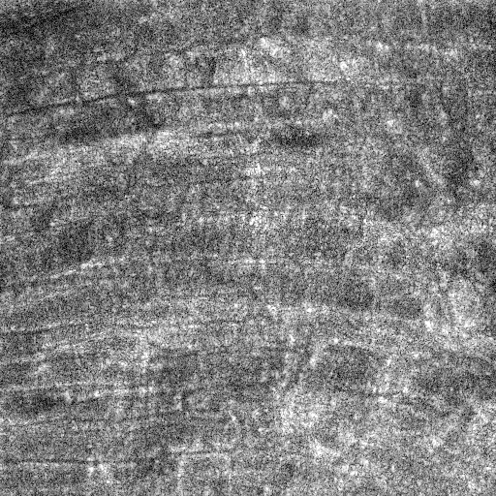
High lateral resolution and long DOF
Computational/holographic refocusing
High-order aberrations
ISAM
(inverse scattering)
Forward-model based method
Adi, PNAS 109, 7175- (2012).
Kumar, OpEx 21, 10850- (2013).
Numerical back-propagation
Numerical correction lens
Sample plane
Focal plane
(x, y, τ) -space
Yasuno, Opt. Express, 14, 1006- (2006).
(fx, fy, k)
Numerical volumetric phase stabilization
For phase-unstable system
Data remapping
Original
Refocused
(fx, fy, fz)
(x, y, z)
Ralston, Nat. Phys. 3, 129- (2007). E.g., Coquz, OpEx 25, 30807- (2017).
Oikawa, BOE 11, 5886- (2020).
Ruiz-Lopera, Opt. Lett 45, 5982- (2020).

Slide 17
Hidden-Assumption and Limitation
τ-z difference
Signal in 4D frequency
f_{z}
f_{z}
Aperture
True sample structure spectrum
f_{x}, f_{y}
becomes thick
for high NA.
Integration
ω
c
Integration
f_{x}, f_{y}
z
Fourier Transform
τ
f_{x}, f_{y}
ω
OCT image spectrum
Conventional computational refocusing does not work for high NA!
Fukutake, Photonics West/BiOS (2020).

Slide 18
Multi-functional imaging

Slide 19
Multi-functional imaging
OCT
Argumentation
Polarization
Temporal property
Polarization-sensitive OCT
OCT angiography
Dynamics imaging
Generalization
Jones matric OCT etc…

Slide 20
Multi-functional imaging
OCT
Argumentation
Polarization
Temporal property
Polarization-sensitive OCT
OCT angiography
Dynamics imaging

Slide 21
Polarization sensitive OCT
Phase retardation imaging = probe beam polarization
De Boer, Opt. Lett. 22, 934- (1997).
Gesperger, Appl. Sci. 9, 2100 (2019). Amyloid beta plaque
Birefringence / local axis imaging = tissue property (?)
Sugiyama, BOE 6, 4951- (2015). Birefringence
Villiger, Optica 5, 1329- (2018). Local optic axis
Open Issue: Non-polarization polarization property imaging (?)

Slide 22
OCT angiography / flow imaging
Doppler OCT
Baumann, BOE 2, 1539- (2011). En-face Doppler.
Z.P. Chen, Opt. Lett. 22, 1119- (1997). 1st Doppler OCT.
Makita, Opt. Express
14, 7821- (2006). Doppler OCTA
Time-variance imaging (OCTA)
D.Y. Kim PNAS
110, 14354- (2013). Phase variance
Y.L. Jia, BOE
20, 4710- (2012). SSADA
Plonar, Retina
36, S118- (2016). VISTA

Slide 23
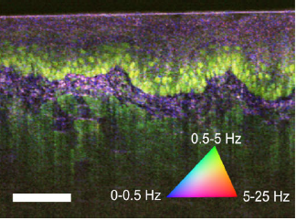
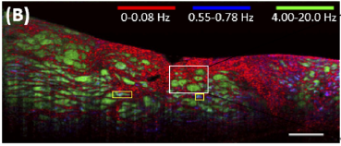
Dynamics imaging
Rat liver
Tumor Spheroid
Murine Tongue
Human esophageal biopsy
Apelian et al., Biomed. Opt. Express, 7, 1511– (2016).
I. A. El-Sadek et al., Biomed. Opt. Express, 11, 6231–(2020).
Münter et al., Opt. Lett., 45, 4766- (2020).
Leung et al., Biomed. Opt. Express, 11, 2768– (2020).
How do we describe “temporal imaging property”?
Slide summarized by Pradipta Mukherjee

Slide 24
Background and current issue: Why should we revise OCT imaging theory?
Drug discovery
Thick tissue culture
(spheroid / organoid)
Effective animal-study
Regenerative medicine
OCT microscope
Label-free imaging
Deep-tissue imaging
Axial & Lateral high-resolution imaging
High NA
Holographic refocusing/AO
Multiple scattering
and Speckle
Axial-lateral interaction
HOT TOPIC!
OCT imaging theory to be revised.

